Slide 1
New development workflow
@DavidBurela
Senior Consultant
Hazaa

Slide 2
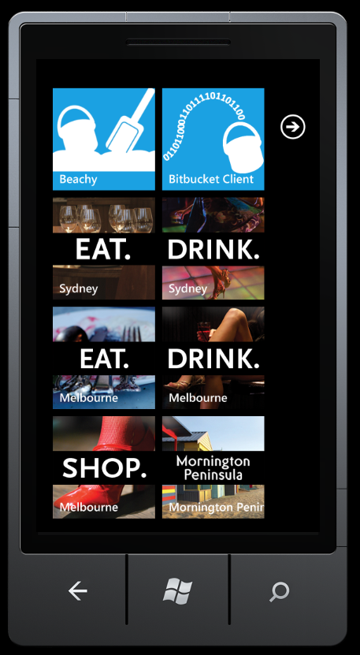
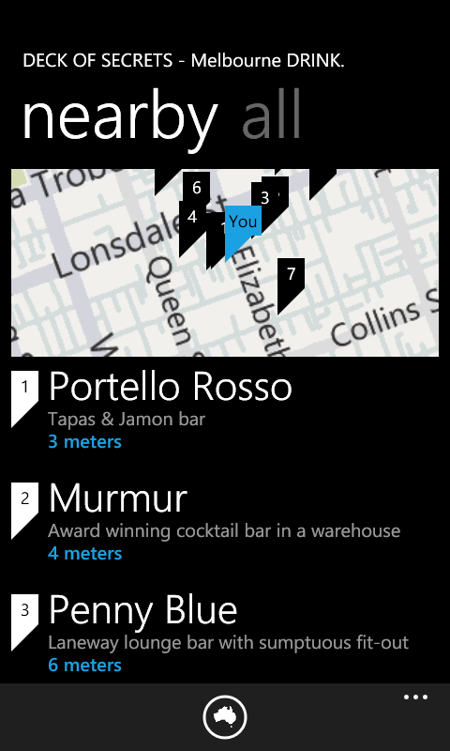
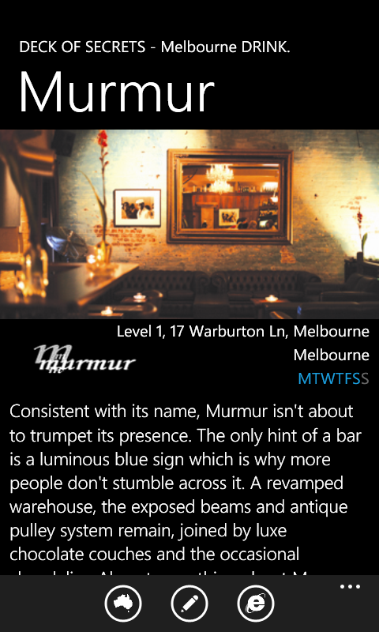
Windows Phone 7 apps

Slide 3
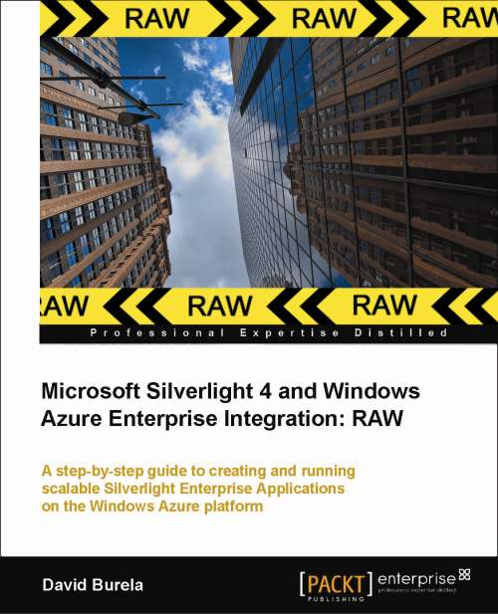
http://tinyurl.com/BurelaAzureBook

Slide 4
Goal for today’s presentation
Demonstrate how new technologies used together can change the workflow of a developer
Build a complete HTML5 website that incorporates continuous deployment.

Slide 5
Technologies
Resharper
Mercurial
TortoiseHg
ASP.Net MVC3 April tools update
NuGet
Ninject
nSubstitute
Bitbucket.org
Appharbor.com

Slide 6
Current paradigms
 | Old | New | Technology
Source | Centralised (TFS / subversion) | DVCS | Mercurial TortoiseHg
Assemblies | Libs folder | Nuget | Nuget
Testing | Manual testing | Unit tests & mocking | Ninject nSubstitute
Build | Bobs machine | Cloud | Appharbor
Deployment | Deploy from Bob’s machine | Auto deployment | Appharbor
Hosting | Local data center | Cloud | Appharbor

Slide 7
Current paradigms
Old
New
Technology
Source
Centralised
DVCS
Mercurial
(
TFS / subversion)
TortoiseHg
Assemblies
Libs folder
Nuget
Nuget
Testing
Manual testing
Unit tests
Ninject
&
mocking
nSubstitute
Build
Bobs machine
Cloud
Appharbor
Deployment
Deploy from Bob’s
Auto deployment
Appharbor
machine
Hosting
Local data
center
Cloud
Appharbor

Slide 8
Current paradigms
Old
New
Technology
Source
Centralised
DVCS
Mercurial
(
TFS / subversion)
TortoiseHg
Assemblies
Libs folder
Nuget
Nuget
Testing
Manual testing
Unit tests
Ninject
&
mocking
nSubstitute
Build
Bobs machine
Cloud
Appharbor
Deployment
Deploy from Bob’s
Auto deployment
Appharbor
machine
Hosting
Local data
center
Cloud
Appharbor

Slide 9
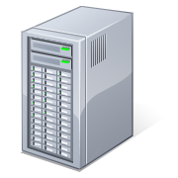
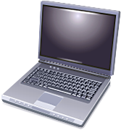
TFS vs DVCS
TFS: Everyone pushes and pulls from the TFS server

Slide 10

TFS vs DVCS
DVCS Workflow
  Check in to your local repository regularly
  Push your changes to a higher level repository
Production
web server
Corporation
repository
Melbourne
team
Sydney
team

Slide 11
Git Vs. Mercurial
Eric Sink on Distributed Version Control Systems http://www.hanselminutes.com/default.aspx?showID=250
Summary:
Git is more linux focused
Mercurial good for Windows

Slide 12
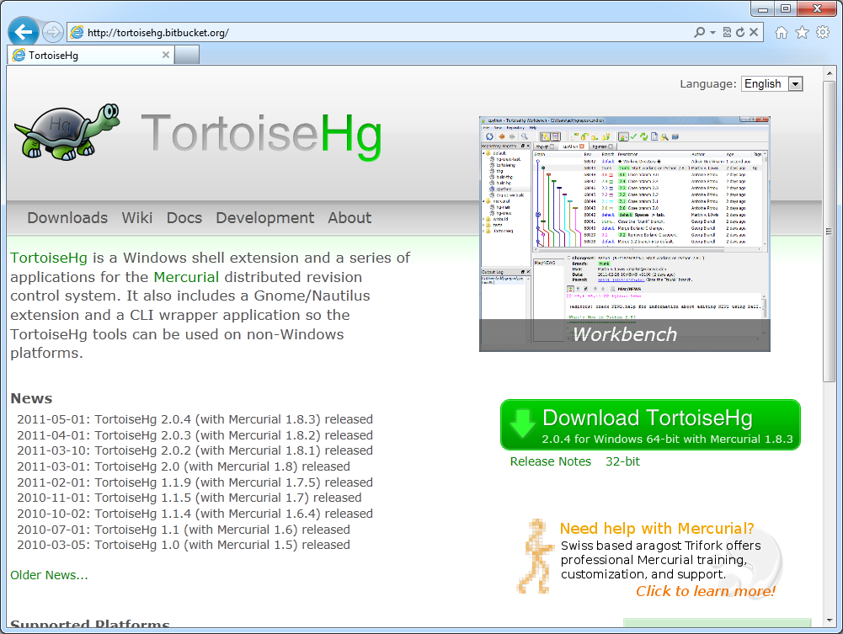
Mercurial
Command line vs. graphical
http://tortoisehg.bitbucket.org/
  Mercurial runtime
  Explorer add-in

Slide 13
Mercurial Demo
Animals
cat
dog
dolpin
salmon
parrot
Kiwi
(new line)

Slide 14
Mercurial Demo
Add categories
Mammals
Non-mammals
KDiff3

Slide 15

Mercurial Demo
Change categories
4 legged
Swimming
flying

Slide 16
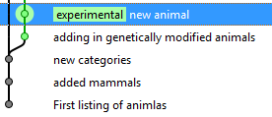
Mercurial Demo
Create a new experimental animals branch
Sharks
Cyber dogs
Another random animal

Slide 17
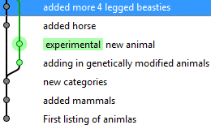
Mercurial Demo
Back to the main branch
Add a horse
Add another animal

Slide 18
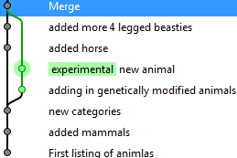
Mercurial Demo
Merge!

Slide 19
Mercurial Demo
Rename an animal
Dolphin -> Dalphin

Slide 20
Mercurial Demo
Leave the changeset as is, but go back 1
Delete an animal

Slide 21
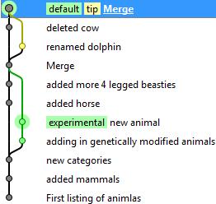
Mercurial Demo
Merge!

Slide 22
Creating the website
Create a new ASP.Net MVC 3
  HTML5 semantics
  Unit test project

Slide 23
Creating the website
Check source code into mercurial
Use a .hgignore file
  Steal from https://bitbucket.org/FunnelWeb

Slide 24
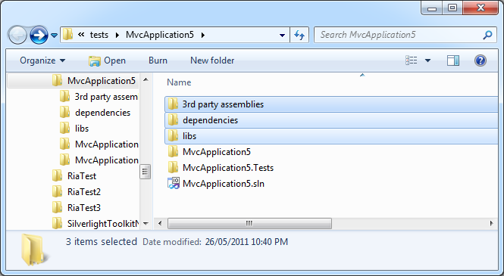
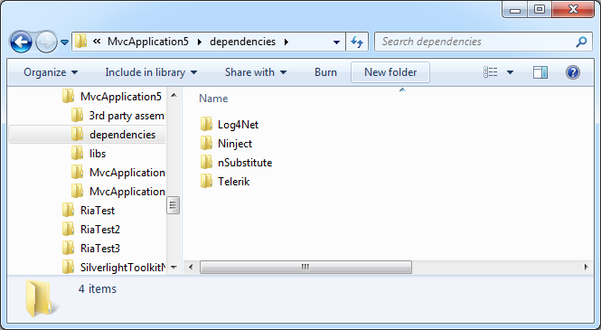
3rd party assemblies
Libs folder

Slide 25
3rd party assemblies
Find the website
Find the correct version (.Net 4.0, Silverlight)
Extract
Copy into libs folder
Etc.
Repeat for each new version

Slide 26
Introducing NuGet
A way to add 3rd party libraries to your project, from an online repository, within Visual Studio.
Easy discovery
Easy installation
Easy upgrades

Slide 27
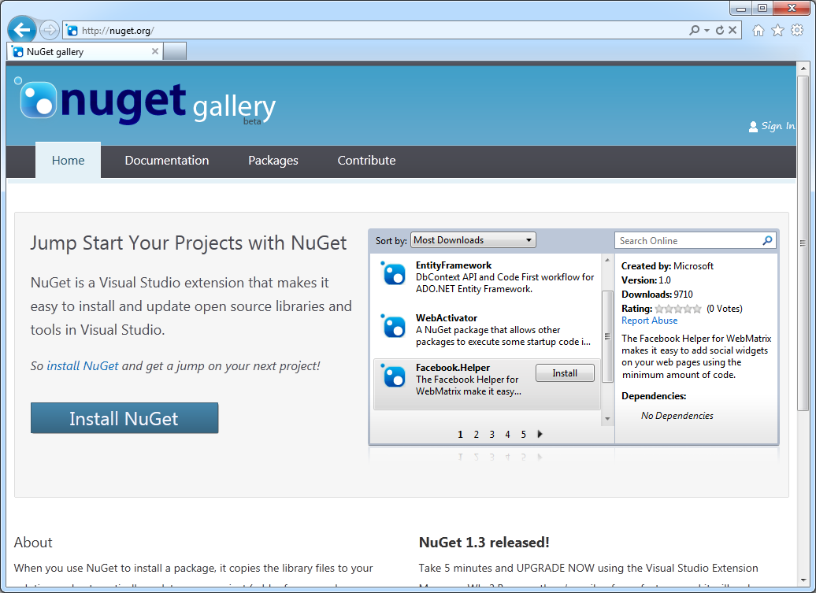
Introducing NuGet
http://nuget.org

Slide 28
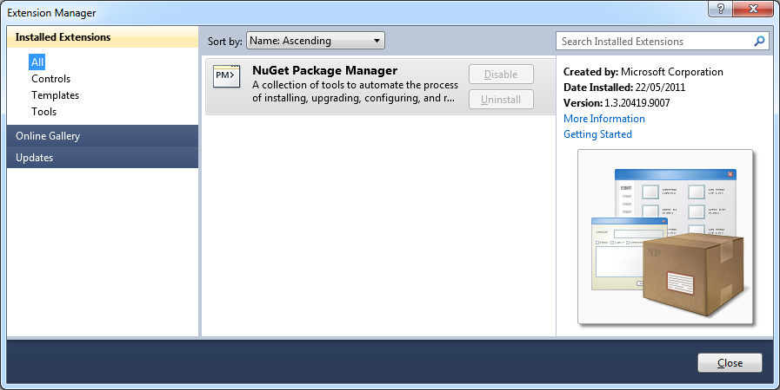
Introducing NuGet
Installed as Visual Studio extension

Slide 29
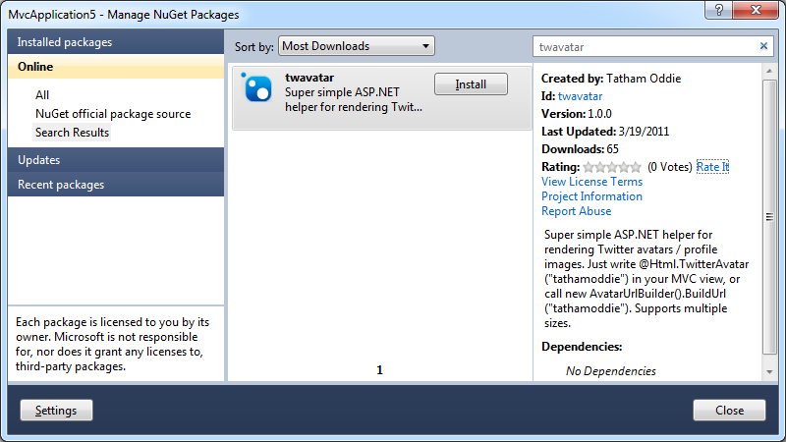
Introducing NuGet
Install TwAvatar
  Right click, Add Package Reference
  Search for package
  Install

Slide 30
Introducing NuGet
jQuery.UI.Combined
Widgets, animations
jQuery
Core jQuery library
jQuery.Validation
Client side validation

Slide 31
Introducing NuGet
Update the current packages

Slide 32
Creating the website
Create & Run unit tests
Make change
ViewBag.Message = "Welcome to the Burela demo";
F5
Run unit tests
Checkin

Slide 33
Creating the website
Add a new property to the dynamic object
  ViewBag.Animals = "Cat, Dog, Elephant, ";
Update the html to include the data
  <p>
  @ViewBag.Animals
  </p>
Check in
Lets get this data from a service instead

Slide 34
Using a data repository
HomeController
Index()
{
var service= new DataService();
var data = service.GetData();
ViewBag.Animals = data;
}

Slide 35
Using a data repository
Has a concrete implementation
Can’t unit test
HomeController
Index()
{
var service = new DataService();
var data = service.GetData();
ViewBag.Animals = data;
}
DataService

Slide 36
Inversion of control
& Dependency Injection
Can pass in different implementations
  Database, webservice, fake
Easier to unit test
DataService
(runtime)
FakeService
(testing)
Known value 1
Known value 2
Known value 3
…
HomeController
Index( IDataService service)
{
var data = service.GetData();
ViewBag.Animals = data;
}

Slide 37
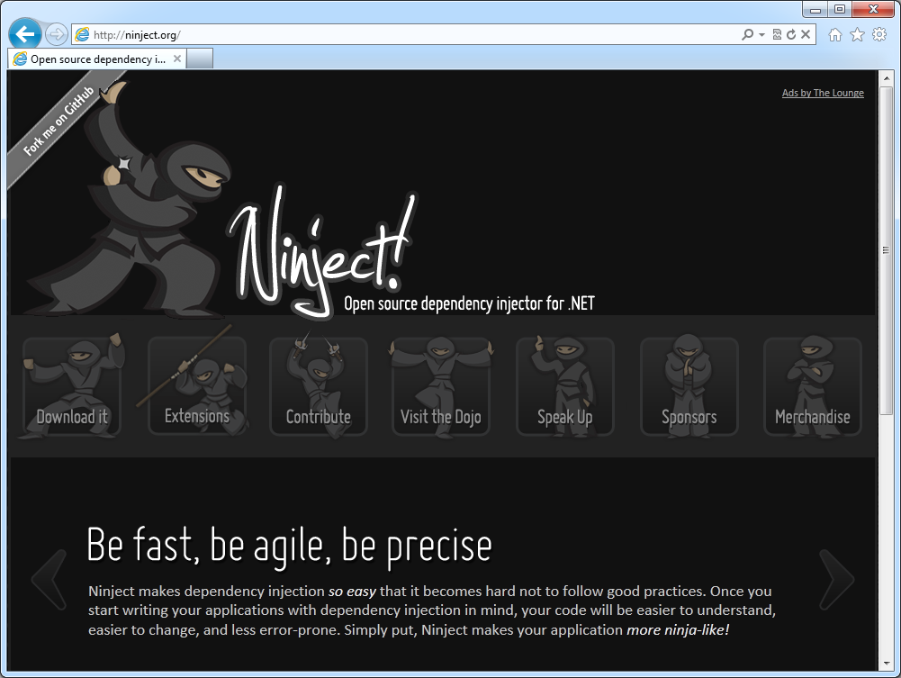
Ninject

Slide 38
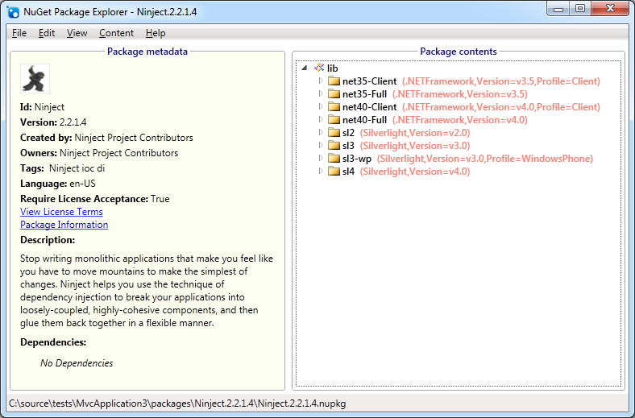
Open .nupack
  Multiple versions of Ninject inside of it

Slide 39
Website
App_Start/NinjectMVC3.cs
Now that we have Ninject, lets continue with the website

Slide 40
Mocking with nSubstitute
[TestMethod]
public void Index()
{
// Arrange
var animalDataService = Substitute.For<IAnimalDataService>();
animalDataService.GetData().Returns(new List<string>
{
"dog", "cat", "rhino"
});
HomeController controller = new HomeController(animalDataService);
// Act
ViewResult result = controller.Index() as ViewResult;
// Assert
Assert.AreEqual(“Animals: dog, cat, rhino, ", result.ViewBag.Animals);
}

Slide 41
Check it all into mercurial again

Slide 42
Pushing to BitBucket
Unlimited free private repositories
Create a new repository
Push the changes
The entire changeset history is pushed

Slide 43
Hosting on AppHarbor
Create a new AppHarbor service
Copy notification URL from AppHarbor
Configure BitBucket to notify AppHarbor when code checked in
AppHarbor pulls the source
  Builds
  Deploys

Slide 44
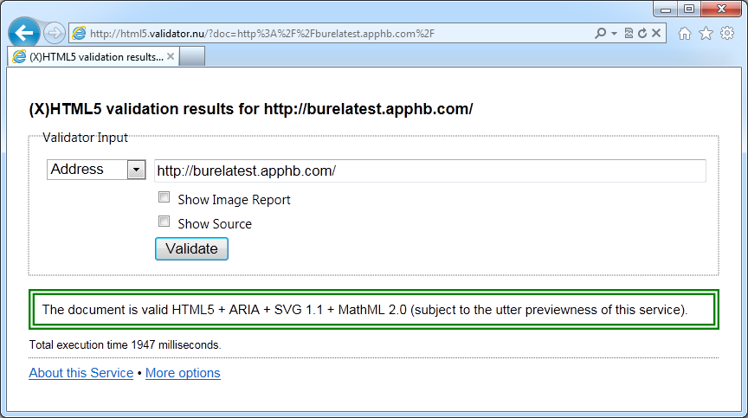
HTML5 validation
http://html5.validator.nu

Slide 45
Break the build
Comment out ViewBag.Message =
Push code to BitBucket
AppHarbor will fail the unit tests
  Cancel deployment

Slide 46
Website authentication
Create a new database on AppHarbor
  The web.config connection string will be replaced automatically
Generate the tables
  aspnet_regsql.exe

Slide 47
Error logging
Install ELMAH
  ELMAH.Quickstart
Trigger some exceptions
View
  http://localhost:31862/elmah.axd

Slide 48
Error logging
ELMAH MVC contrib
  Adds [ElmahHandleErrorAttribute] attribute
  http://stackoverflow.com/questions/766610/how-to-get-elmah-to-work-with-asp-net-mvc-handleerror-attribute/

Slide 49
Error logging
Enabling secured remote access
<!--Allow remote access to the Elmah logs-->
<elmah>
<security allowRemoteAccess="True" />
</elmah>
<!--Secure the logs to authenticated users-->
<location path="elmah.axd">
<system.web>
<authorization>
<deny users="?" />
</authorization>
</system.web>
</location>

Slide 50
Error logging
App is running on multiple cloud instances
  Each server is keeping a local ELMAH log
  Create a new AppHarbor database
  Change web.config

Slide 51
Current paradigms
Old
New
Technology
Source
Centralised
DVCS
Mercurial
(
TFS / subversion)
TortoiseHg
Assemblies
Libs folder
Nuget
Nuget
Testing
manual testing
unit tests
Ninject
&
mocking
nSubstitute
Build
Bobs machine
Cloud
Appharbor
Hosting
Local data
center
Cloud
Appharbor
Deployment
Deploy from Bob’s
auto deployment
Appharbor
machine

Slide 52
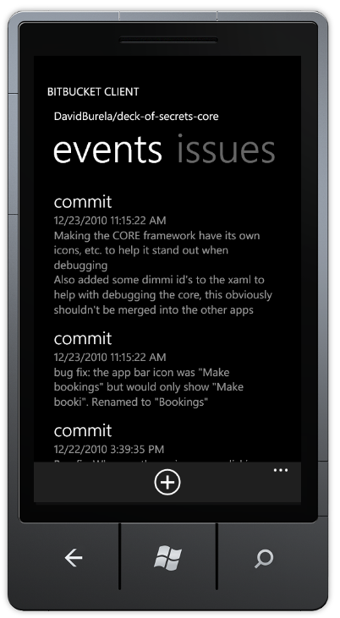
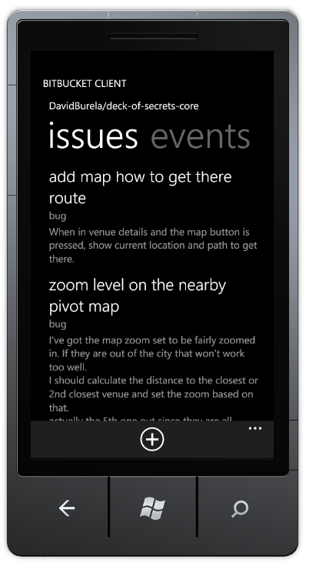
Bitbucket client

Slide 53
Checking packages into source control
Is it required to check the packages into source control?
Nuget install packages.config

