Slide 1
Windows Presentation Foundation
David Burela
Senior Developer, Readify

Slide 2
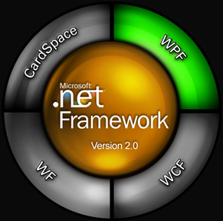
What is WPF?
Stands for Windows Presentation Foundation
One of the 4 pillars of .NET 3.0
Microsoft’s latest rendering technology for creating rich client applications

Slide 3
Basics
Built on top of DirectX
Windows Presentation Foundation
  Controls
  Data binding
  Layout
  2-D and 3-D graphics
  Animation
  Styles
  Templates
  Media
  Documents, typography

Slide 4



Separating things
XAML
C#
Designer
Look and feel
Wiring controls to methods
Animation
Style
...
Programmer
Retrieving data
Submitting results
Responding to events
…

Slide 5
Controls
Standard (Button, TextBox, etc.)
Media element - embedded movies/streaming movies
Layout
Controls can be nested
NO DataGrid! (initially)
  DataTemplates are a much nicer way to display data

Slide 6
Using XAML to Define UI
Demo

Slide 7
Animation
Declarative animation
Almost any property that can be set can be animated
  Height, position, background colour
  Size/rotation/colour
Can be animated easily using Expression blend

Slide 8
Animation with expression blend
Demo

Slide 9
Styles
Used to set the property of more than one element
  Can theme an entire application
  Define button styles, list styles, etc.
Similar to CSS
  Inheritance (Extending styles)
Default style vs. explicit style setting

Slide 10
Styles
Demo

Slide 11
DataBinding
Similar to Winforms and ASP.Net databinding
Databind datasources to controls
  Automatically populate controls with data
  Automatic refreshing
No DataGrid control to databind collections to
DataTemplate tells data how to display itself

Slide 12
DataBinding
Demo

Slide 13
Shiny things
Demo

Slide 14
Silverlight
WPF
  Requires windows PC with full .Net 3.5 SP1 runtime
Silverlight
  Subset of WPF
  Only requires a 4mb installer
  PC, Mac & Linux
  IE, Firefox, Opera, Safari, Chrome

Slide 15
A Readify Developer Network session
By David Burela, Senior Developer, Readify
Email Address: David.Burela@readify.net
Resources on Blog: http://DavidBurela.wordpress.com

