Slide 1
Windows Workflow Foundation
David Burela
Senior Developer, Readify

Slide 2
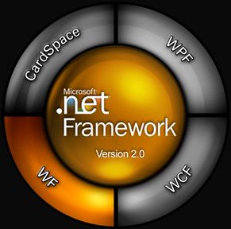
What is WF?
Stands for Windows Workflow Foundation (not WWF….)
One of the 4 pillars of .NET 3.0
Way to declaratively create “workflows” that can be hosted in applications

Slide 3
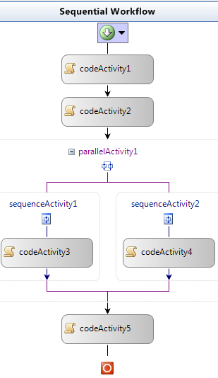
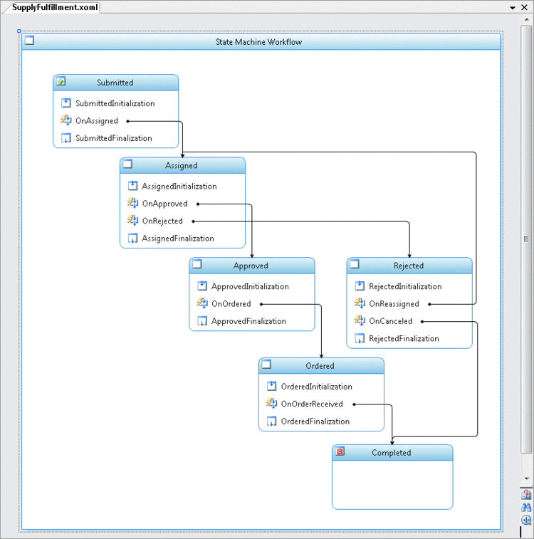
Workflow types
Sequential
  Starts at the top. Flows downwards
  Production line
State machine
  Goes from one “state” to another
  Document management system

Slide 4
Hosting WF
Workflows can be hosted in any .Net app
  Console, winforms, WPF, ASP.Net
Integration into other Microsoft tech
  Sharepoint
  Biztalk
  WCF

Slide 5
Hamburger Construction
Demo

Slide 6
Scheduler service
DefaultWorkflowSchedulerService
  Asynchronous scheduling of workflow instances
  (Client hosting)
ManualWorkflowScheduler Service
  Synchronous scheduling
  (Server hosting)
Choosing scheduler service is important

Slide 7
Persistence Service
Persistent Services are used to persist state about a Workflow instance
The Workflow runtime engine determines when persistence should occur
Protects against power loss, etc.
Reduces memory footprint

Slide 8
Versioning
Massive pain point
Persistence problems
Changing code in an activity may be fine
Restructuring will come up against problems
Research on the web!

Slide 9
A Readify Developer Network session
By David Burela, Senior Developer, Readify
Email Address: David.Burela@readify.net
Resources on Blog: http://DavidBurela.wordpress.com

