Slide 1
New development workflow
@DavidBurela
Senior Consultant Hazaa

Slide 2
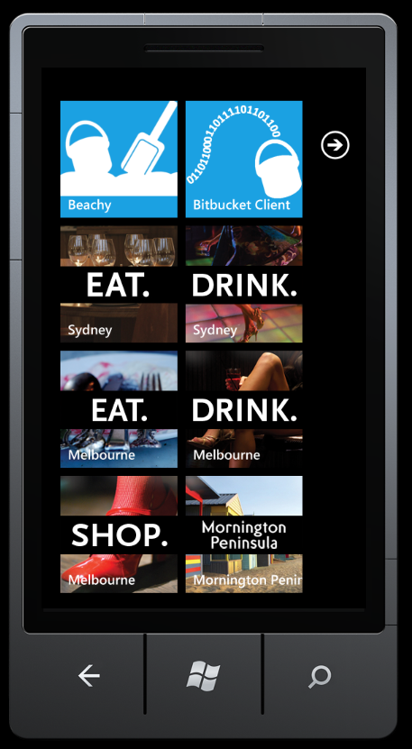
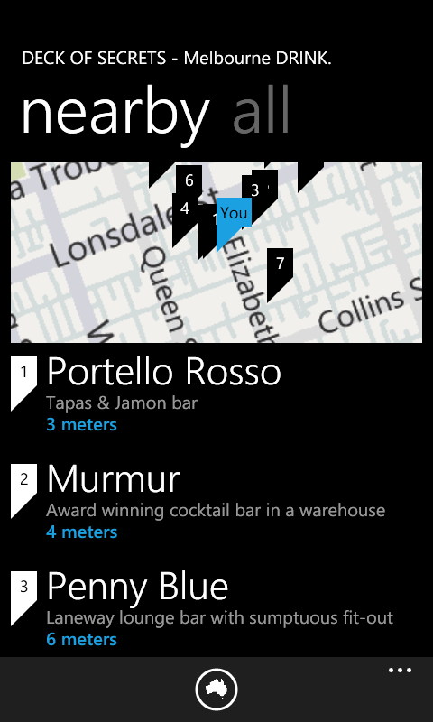
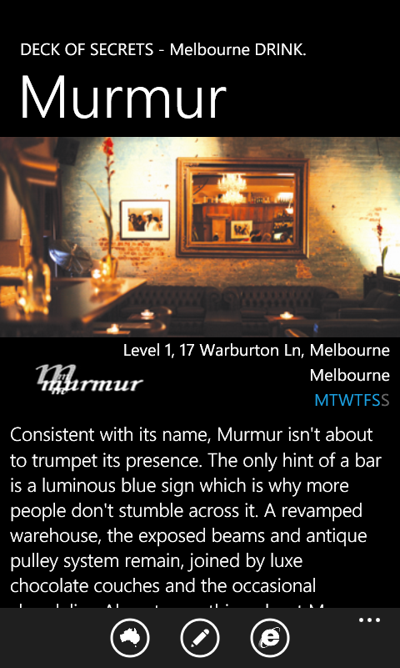
Windows Phone 7 apps

Slide 3
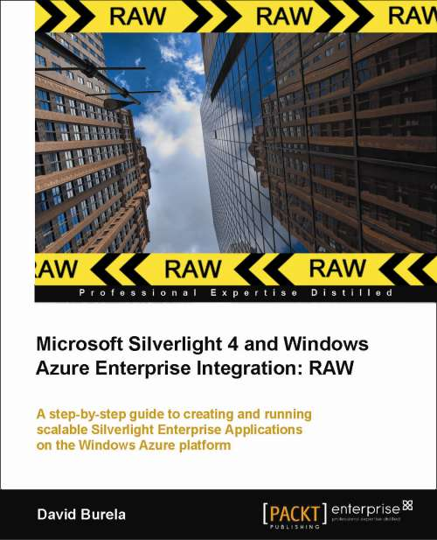
http://tinyurl.com/BurelaAzureBook

Slide 4
Goal for today’s presentation
Demonstrate how new technologies used together can change the workflow of a developer
Build a complete HTML5 website that incorporates continuous deployment.

Slide 5
Technologies
Resharper
Mercurial
TortoiseHg
ASP.Net MVC3 April tools update
NuGet
Ninject
nSubstitute
Bitbucket.org
Appharbor.com

Slide 6
Current paradigms
 | Old | New | Technology
Source | Centralised (TFS / subversion) | DVCS | Mercurial TortoiseHg
assemblies | libs folder | Nuget | Nuget
Build* | Bobs machine | Cloud | Appharbor
Hosting | Local data center | Cloud | Appharbor
deployment | Deploy from Bob’s machine | auto deployment | Appharbor
Testing | manual testing | unit tests & mocking | Ninject nSubstitute

Slide 7
Current paradigms
Old
New
Technology
Source
Centralised
DVCS
Mercurial
(TFS / subversion)
TortoiseHg
3rd party
Assemblies
libs folder
Assembly repository
NuGet
Build
Bob’s machine
Cloud
Appharbor
Hosting
Local data center
Cloud
Appharbor
deployment
Deploy from
Bob’s machine
auto deployment
(from the cloud)
Appharbor
Testing
manual testing
unit tests
Ninject
&
mocking
nSubstitute

Slide 8
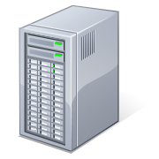
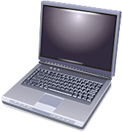
TFS vs DVCS
TFS: Everyone pushes and pulls from the TFS server

Slide 9
TFS vs DVCS
DVCS Workflow
Check in to your local repository regularly
Push your changes to a higher level repository
Production
web server
Corporation
repository
Melbourne
team
Sydney
team

Slide 10
Git Vs. Mercurial
Eric Sink on Distributed Version Control Systems http://www.hanselminutes.com/default.aspx?showID=250
Summary: Git is more linux focused Mercurial good for Windows

Slide 11
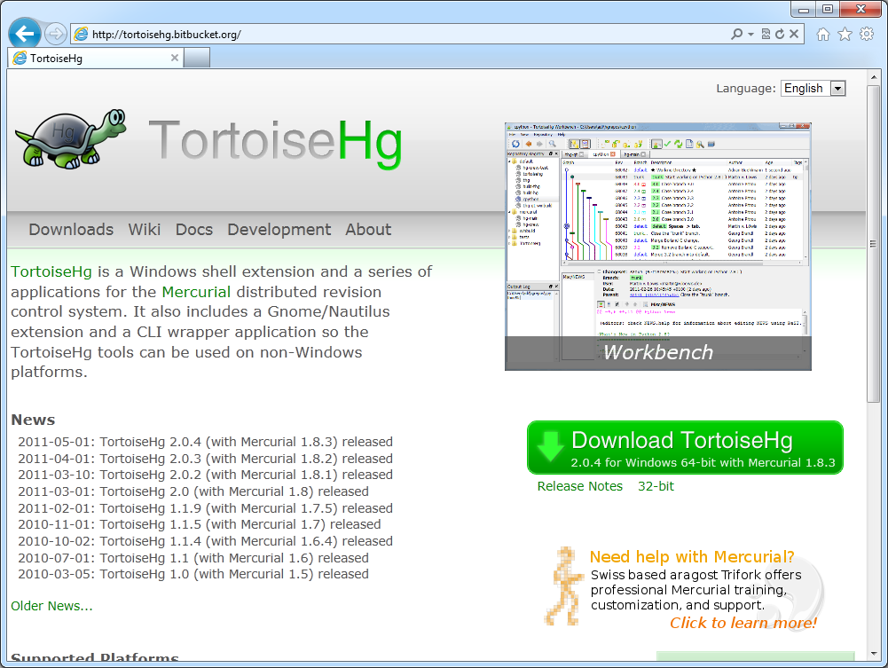
Mercurial
Command line vs. graphical
http://tortoisehg.bitbucket.org/
Mercurial runtime
Explorer add-in

Slide 12
Mercurial Demo
Animals
cat
dog
dolpin
salmon
parrot
Kiwi
(new line)

Slide 13
Mercurial Demo
Add categories
Mammals
Non-mammals
KDiff3

Slide 14
Mercurial Demo
Change categories
4 legged
Swimming
flying

Slide 15
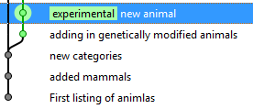
Mercurial Demo
Create a new experimental animals branch
Sharks
Cyber dogs
Another random animal

Slide 16
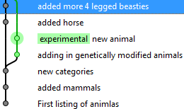
Mercurial Demo
Back to the main branch
Add a horse
Add another animal

Slide 17
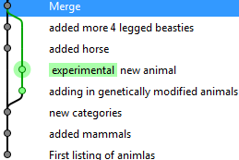
Mercurial Demo
Merge!

Slide 18
Mercurial Demo
Rename an animal
Dolphin -> Dalphin

Slide 19
Mercurial Demo
Leave the changeset as is, but go back 1
Delete an animal

Slide 20
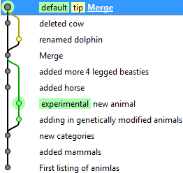
Mercurial Demo
Merge!

Slide 21
Creating the website
Create a new ASP.Net MVC 3
HTML5 semantics
Unit test project

Slide 22
Creating the website
Check source code into mercurial
Use a .hgignore file
Steal from https://bitbucket.org/FunnelWeb

Slide 23
Creating the website
Run unit tests
Make change ViewBag.Message = "Welcome to the Burela demo";
F5
Run unit tests
Checkin

Slide 24
Creating the website
Add a new property to the dynamic object
ViewBag.Animals = "Cat, Dog, Elephant, ";
Update the html to include the data
<p> @ViewBag.Animals </p>
Check in
Lets get this data from a service instead

Slide 25
Using a data repository
HomeController
Index()
{
var service= new DataService();
var data = service.GetData();
ViewBag.Animals = data;
}

Slide 26
Using a data repository
HomeController
Index()
{
var service = new DataService();
var data = service.GetData();
ViewBag.Animals = data;
}
DataService
Has a concrete implementation
Can’t unit test

Slide 27
Inversion of control & Dependency Injection
DataService
(runtime)
FakeService
(testing)
Known value 1
Known value 2
Known value 3
…
HomeController
Index( IDataService service)
{
var data = service.GetData();
ViewBag.Animals = data;
}
Can pass in different implementations
Database, webservice, fake
Easier to unit test

Slide 28
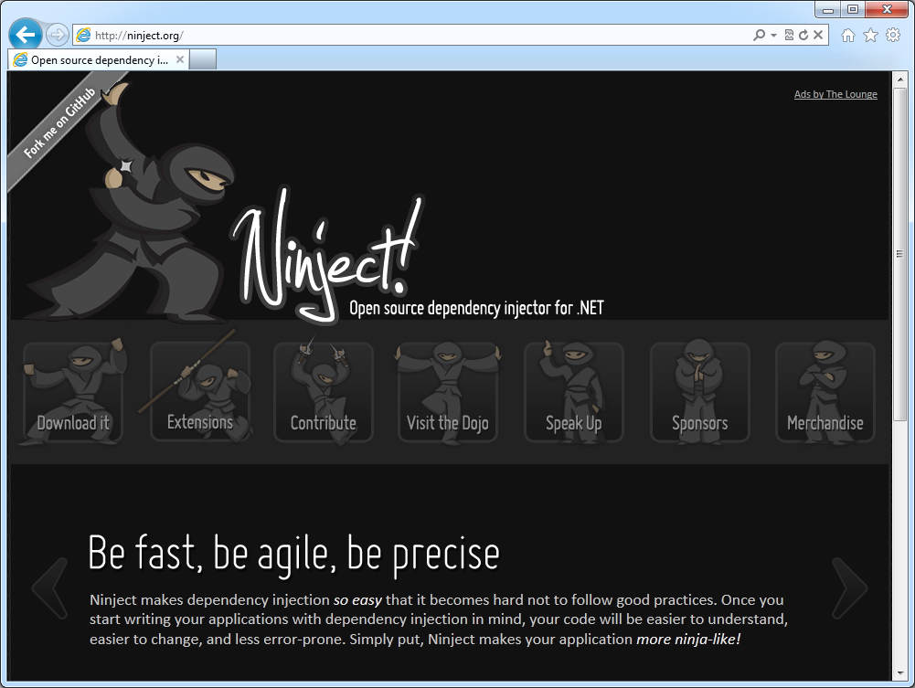
Ninject

Slide 29
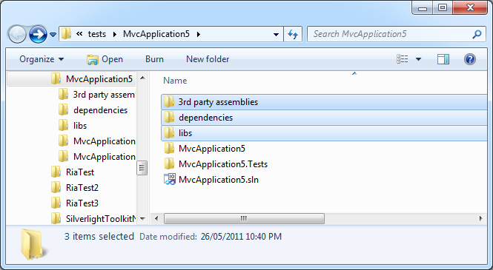
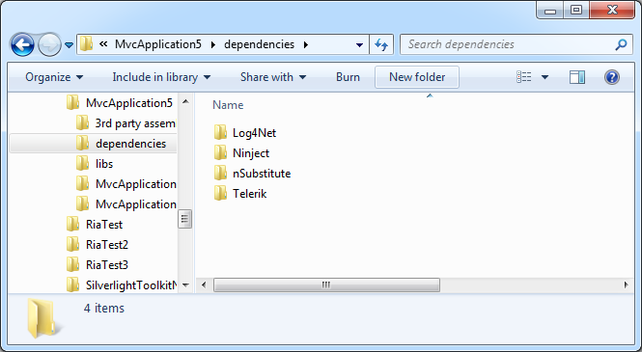
3rd party assemblies
Libs folder

Slide 30
3rd party assemblies
Find the website
Find the correct version (.Net 4.0, Silverlight)
Extract
Copy into libs folder
Etc.
Repeat for each new version

Slide 31
Introducing NuGet
A way to add 3rd party libraries to your project, from an online repository, within Visual Studio.
Easy discovery
Easy installation
Easy upgrades

Slide 32
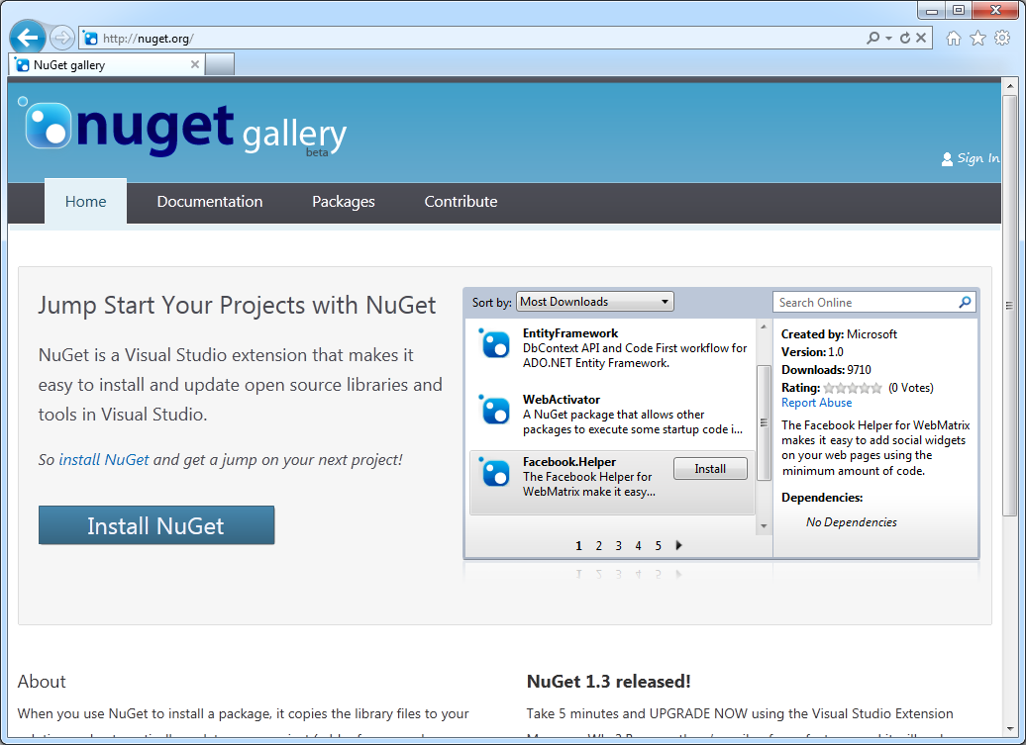
Introducing NuGet
http://nuget.org

Slide 33
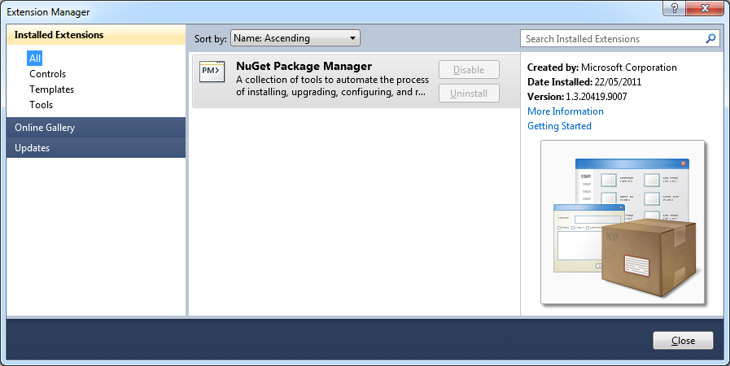
Introducing NuGet
Installed as Visual Studio extension

Slide 34
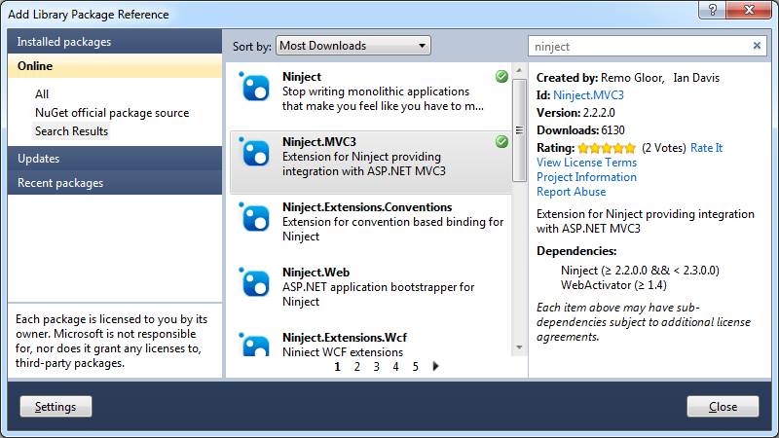
Introducing NuGet
Install Ninject
Right click, Add Package Reference
Search for package
Install

Slide 35
Introducing NuGet
Web Activator
Allows other NuGet packages
to execute code at start up
Ninject.MVC
Adds startup code to the app
enables Ninject IoC
Ninject
The Ninject .DLL files

Slide 36
Introducing NuGet
Update the current packages

Slide 37
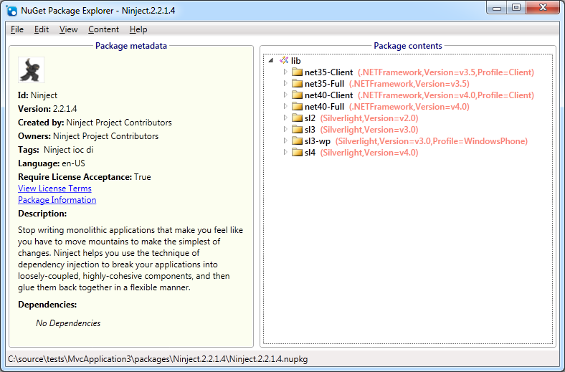
Introducing NuGet
Open .nupack
Multiple versions of Ninject inside of it

Slide 38
Website
App_Start/NinjectMVC3.cs
Now that we have Ninject, lets continue with the website

Slide 39
Inversion of control & Dependency Injection
DataRepository
(runtime)
FakeRepository
(testing)
Known value 1
Known value 2
Known value 3
…
HomeController (IDataService dataService)
Index()
{
var data = dataService.GetData();
ViewBag.Animals = data;
}
Can pass in different implementations
Easier to unit test

Slide 40
Mocking with nSubstitute
[TestMethod]
public void Index()
{
// Arrange
var animalDataService = Substitute.For<IAnimalDataService>();
animalDataService.GetData().Returns(new List<string>
{
"dog", "cat", "rhino"
});
HomeController controller = new HomeController(animalDataService);
// Act
ViewResult result = controller.Index() as ViewResult;
// Assert
Assert.AreEqual(“Animals: dog, cat, rhino, ", result.ViewBag.Animals);
}

Slide 41
Check it all into mercurial again

Slide 42
Pushing to BitBucket
Unlimited free private repositories
Create a new repository
Push the changes
The entire changeset history is pushed

Slide 43
Hosting on AppHarbor
Create a new AppHarbor service
Copy notification URL from AppHarbor
Configure BitBucket to notify AppHarbor when code checked in
AppHarbor pulls the source
Builds
Deploys

Slide 44
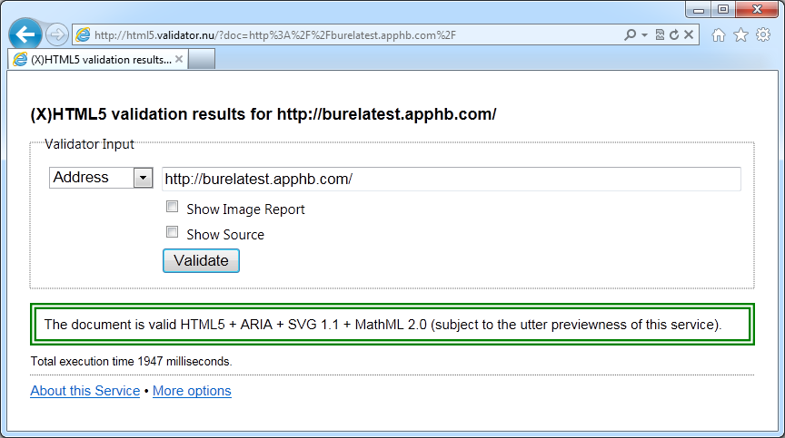
HTML5 validation
http://html5.validator.nu

Slide 45
Break the build
Comment out ViewBag.Message =
Push code to BitBucket
AppHarbor will fail the unit tests
Cancel deployment

Slide 46
Website authentication
Create a new database on AppHarbor
The web.config connection string will be replaced automatically
Generate the tables
aspnet_regsql.exe

Slide 47
Error logging
Install ELMAH
ELMAH.Quickstart
Trigger some exceptions
View
http://localhost:31862/elmah.axd

Slide 48
Error logging
ELMAH MVC contrib
Adds [ElmahHandleErrorAttribute] attribute
http://stackoverflow.com/questions/766610/how-to-get-elmah-to-work-with-asp-net-mvc-handleerror-attribute/

Slide 49
Error logging
Enabling secured remote access
<!--Allow remote access to the Elmah logs-->
<elmah>
<security allowRemoteAccess="True" />
</elmah>
<!--Secure the logs to authenticated users-->
<location path="elmah.axd">
<system.web>
<authorization>
<deny users="?" />
</authorization>
</system.web>
</location>

Slide 50
Error logging
App is running on multiple cloud instances
Each server is keeping a local ELMAH log
Create a new AppHarbor database
Change web.config

Slide 51
Recap
Old
New
Technology
Source
Centralised
DVCS
Mercurial
(TFS / subversion)
TortoiseHg
3rd party
Assemblies
libs folder
Assembly repository
NuGet
Build
Bob’s machine
Cloud
Appharbor
Hosting
Local data center
Cloud
Appharbor
deployment
Deploy from
Bob’s machine
auto deployment
(from the cloud)
Appharbor
Testing
manual testing
unit tests
Ninject
&
mocking
nSubstitute

Slide 52
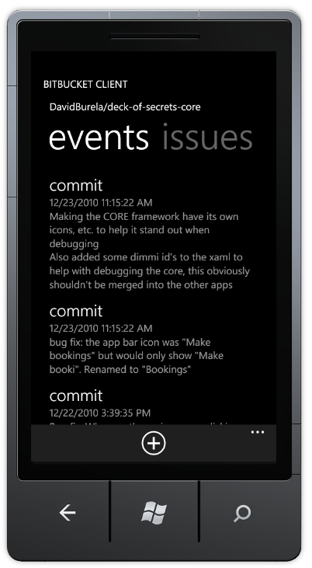
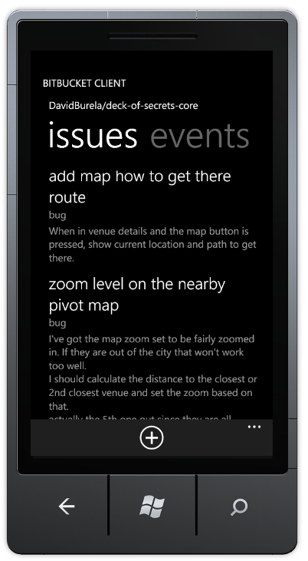
Bitbucket client

Slide 53
Checking packages into source control
Is it required to check the packages into source control?
Nuget install packages.config

